Slide 1

“Employee Data Analysis using SQL”
Internship Project – Soulvibe.Tech
K Omsathyaprakash
Batch : SVT/DAINT/2025/06/B09
Role : Data Analyst Intern

Slide 2
Introduction
Overview of the Main Objectives
The main objective of this project was to analyze employee demographics and income patterns using SQL. Through a series of targeted queries, the analysis aimed to uncover insights on employment status, income distribution, education impact, and housing trends. Key tasks included calculating averages, rankings, counts, cumulative values, and identifying top earners. This helped in better understanding workforce characteristics and socio-economic patterns across different groups in the dataset.

Slide 3

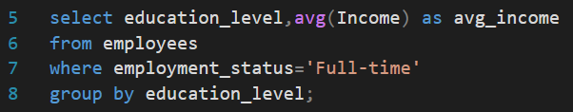
Average income for each Education_Level for those who are employed full-time
1
Explanation: • This query calculates the average income for each education level
among employees who are employed full-time. • It uses WHERE to filter only those with employment_status = 'Full-time'. • The AVG(Income) function computes the average income for each group. • GROUP BY education_level groups the data based on education qualifications. • The result displays the average income per education level for full-time employees.
Result Highlight: • Full-time employees with a High School education have the highest average income of 823,454.

Slide 4

Retrieve the top 5 highest earning individuals and their details.
2
Explanation: • This query retrieves the details of the top 5 highest earning individuals from the employees table. • It uses ORDER BY income DESC to sort employees by income in descending order. • SELECT TOP 5 * fetches the top 5 rows after sorting, i.e., the 5 highest earners. • The result displays all available columns for each of these individuals.
Result Highlight: • The highest earning individual has an income of 9,992,571, holds a Bachelor’s degree,
works in the Healthcare sector , and is employed part-time.

Slide 5
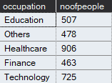
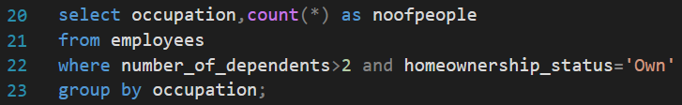
Count how many people in each Occupation have more than 2 dependents and own a house.
3
Explanation:
This query counts the number of people in each occupation who have more than 2 dependents and own a house.
The WHERE clause filters the rows to include only those who satisfy both conditions: number_of_dependents > 2 homeownership_status = 'Own'
The GROUP BY clause groups the data based on the occupation.
COUNT(*) counts the total number of individuals in each occupation who meet the filter criteria.
Result Highlight:
The Healthcare sector has the highest number of individuals (906) who have more than 2 dependents and own a house.
The Technology sector follows with 725 individuals.
This insight helps in understanding which occupational groups tend to have larger families and homeownership.

Slide 6
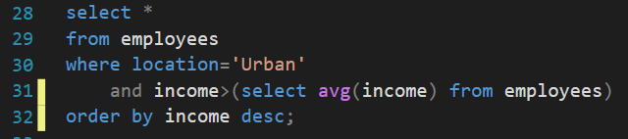
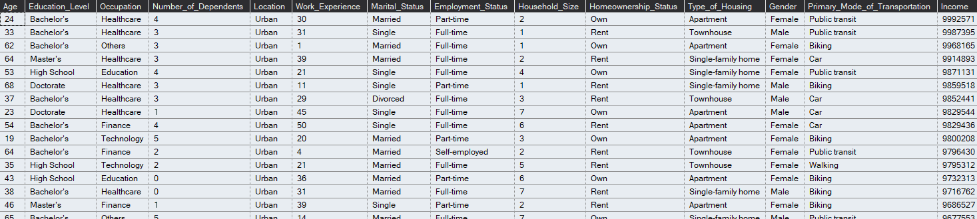
List all individuals living in Urban locations with an income above the average income.
4
Explanation:
Retrieves individuals who live in Urban areas and earn more than the average income.
Uses a subquery to calculate the average income.
Displays all details of the qualifying individuals.
Result Highlight:
Top Urban earner has an income of 9,992,571, works in Healthcare, and is part-time.

Slide 7
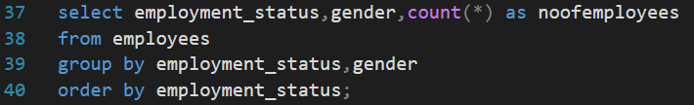
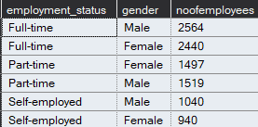
Identify how many males and females are in each Employment_Status.
5
Explanation:
Groups data by employment status and gender.
Counts how many males and females are in each employment type.
Results are ordered by employment status.
Result Highlight:
Full-time: ~2,500 males and females each.
Part-time: Slightly more males (1,519) than females (1,497).
Self-employed: More males (1,040) than females (940).

Slide 8
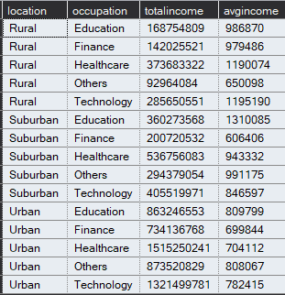
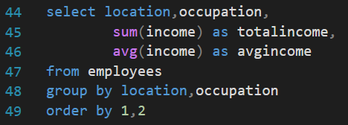
What is the total and average income by Location and Occupation?
6
Explanation: • This query calculates the total and average income for each combination of location and occupation. • It uses GROUP BY location, occupation to group the records accordingly. • SUM(income) computes the total income for each group. • AVG(income) calculates the average income for each group. • The result is sorted by location and then occupation using ORDER BY 1, 2.
Result Highlight: • The highest total income is for Urban Healthcare, totaling 1,515,250,241. • The highest average income is for Rural Technology, averaging 1,195,190.

Slide 9
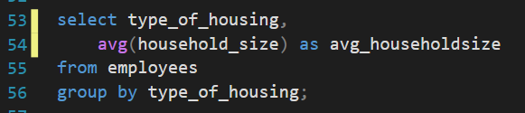

Find the average Household_Size grouped by Type_of_Housing.
7
Explanation:
• This query calculates the average household size for each type of housing.
• The GROUP BY type_of_housing groups the records based on housing type.
• AVG(household_size) computes the average household size within each group.
• The result provides insight into household size variations across different housing types.
Result Highlight:
• The average household size for Apartments is 3.
• The average household size for Townhouses is 4.
• The average household size for Single-family homes is 3.

Slide 10
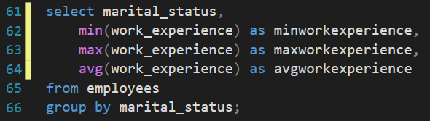

Calculate the minimum, maximum, and average Work_Experience for each Marital_Status.
8
Explanation:
• This query calculates the minimum, maximum, and average work experience for each marital status.
• The GROUP BY marital_status groups the records based on marital status.
• MIN(work_experience) retrieves the lowest work experience in each group.
• MAX(work_experience) retrieves the highest work experience in each group.
• AVG(work_experience) computes the average work experience within each group.
Result Highlight:
The minimum and maximim work experience of all the three marital status are the same and
the average work experience is 1 year more for the married.

Slide 11

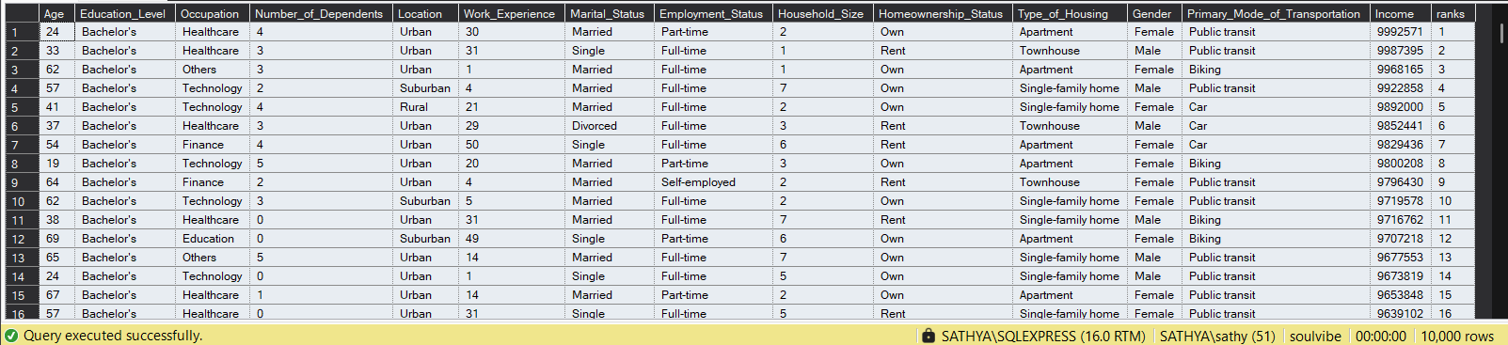
Write a query to rank individuals by Income within each Education_Level.
9
Explanation: • The RANK() window function is used to assign a rank to each individual. • PARTITION BY education_level ensures the ranking resets for each education level. • ORDER BY income DESC ranks individuals in descending order of income within each group. • The result adds a ranks column showing income-based rank for each person in their education level.
Result Highlight: • Individuals are ranked within their education level group based on their income. • For example, among those with a Bachelor’s degree, the highest income (9,925,571) gets rank 1.

Slide 12
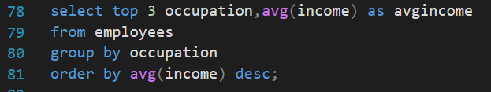

Find the top 3 Occupation types with the highest average income.
10
Explanation: • This query retrieves the top 3 occupation types with the highest average income. • The GROUP BY occupation groups the data based on occupation. • AVG(income) calculates the average income for each occupation group. • The ORDER BY avg(income) DESC sorts the results in descending order of average income. • SELECT TOP 3 limits the output to the top 3 occupations with the highest average income.
Result Highlight: • The average income for Education is 920,816. • The average income for Technology is 836,173. • The average income for Others is 828,970.

Slide 13
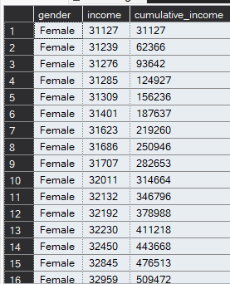
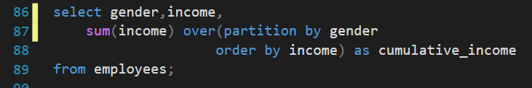
Use a window function to calculate the cumulative income for each Gender.
11
Explanation: • The SUM(income) function is used to compute a running total of income. • PARTITION BY gender ensures that cumulative totals are calculated separately for each gender. • ORDER BY income sorts incomes in ascending order before summing, ensuring cumulative
calculation follows that order. • The result adds a cumulative_income column showing the progressive total income for each gender group.
Result Highlight: • For Female gender: The cumulative income starts at 31,127 and increases with each additional income value. • Each row adds the income of that individual to the sum of all previous rows (within the same gender group).

Slide 14
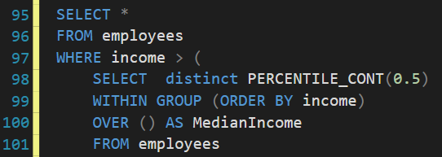
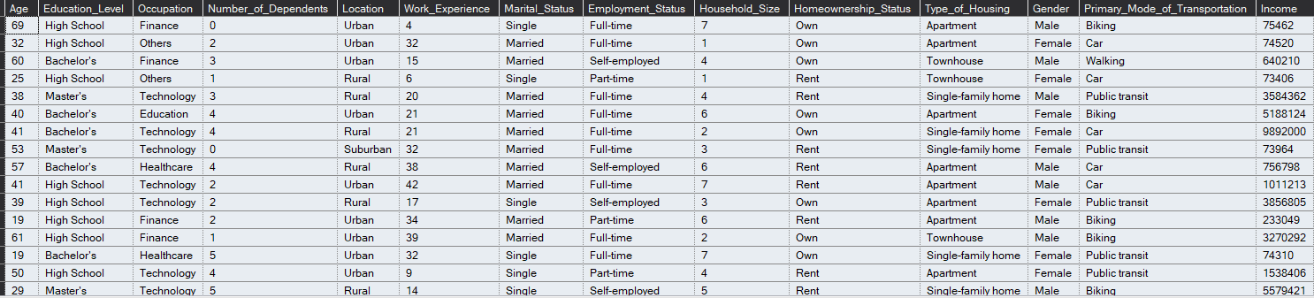
List the people whose income is above the median income for the dataset.
12
Explanation:
PERCENTILE_CONT(0.5) is a continuous percentile function used to calculate the median
(50th percentile) income.
WITHIN GROUP (ORDER BY income) ensures that the incomes are sorted before calculating the percentile.
OVER () tells the database to calculate the median over the entire dataset (no partitioning).
The subquery returns the median income, and the main query filters for rows
where the employee's income is greater than this median value.
Result Highlight:
The query returns only those employees whose income exceeds the median.

Slide 15
Conclusion
Through this internship project with Soulvibe.Tech, I explored employee data using SQL and gained valuable experience in:
Writing optimized SQL queries for real-world datasets
Extracting key insights on demographics, income, housing, and employment patterns
Using aggregation, ranking, window functions, and filtering techniques effectively
Drawing conclusions that can inform workforce and socio-economic decision-making
This project enhanced my practical skills in SQL forming a strong foundation for more advanced data analytics and visualization.

Slide 16
THANK YOU

